Slide 1
Deep Object Detection Methods: Benchmarking and Sensitivity Analysis
By: Daniel Griffin, Yudhister Satija

Slide 2
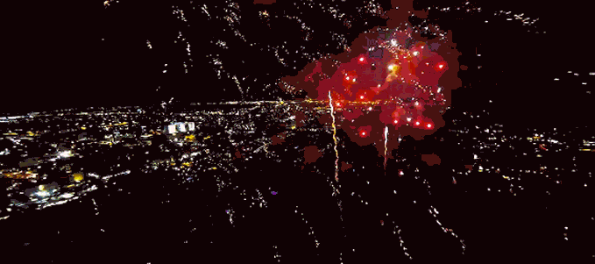
Deepnets

Slide 3
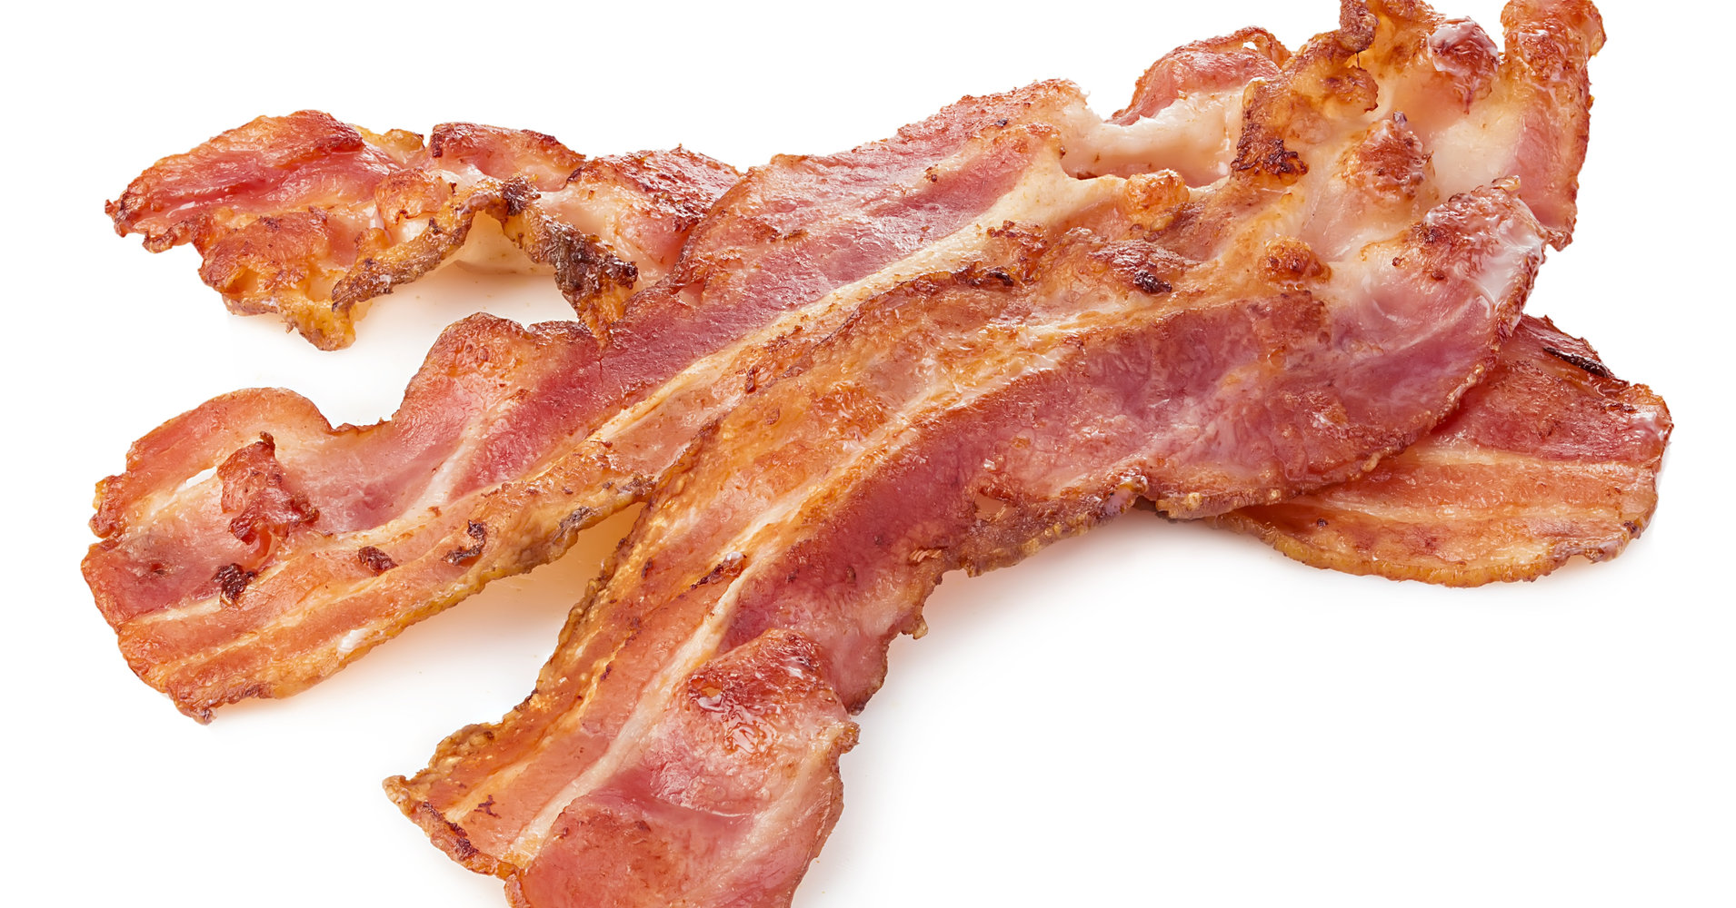

Deepnets are the new Bacon.
However, no one is really asking the question, How good is this Bacon?

Slide 4

Background: The Problem

Slide 5
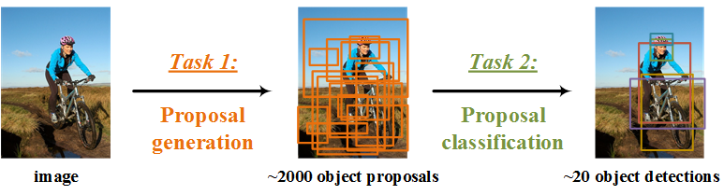
Object Classification Vs Region Proposal

Slide 6
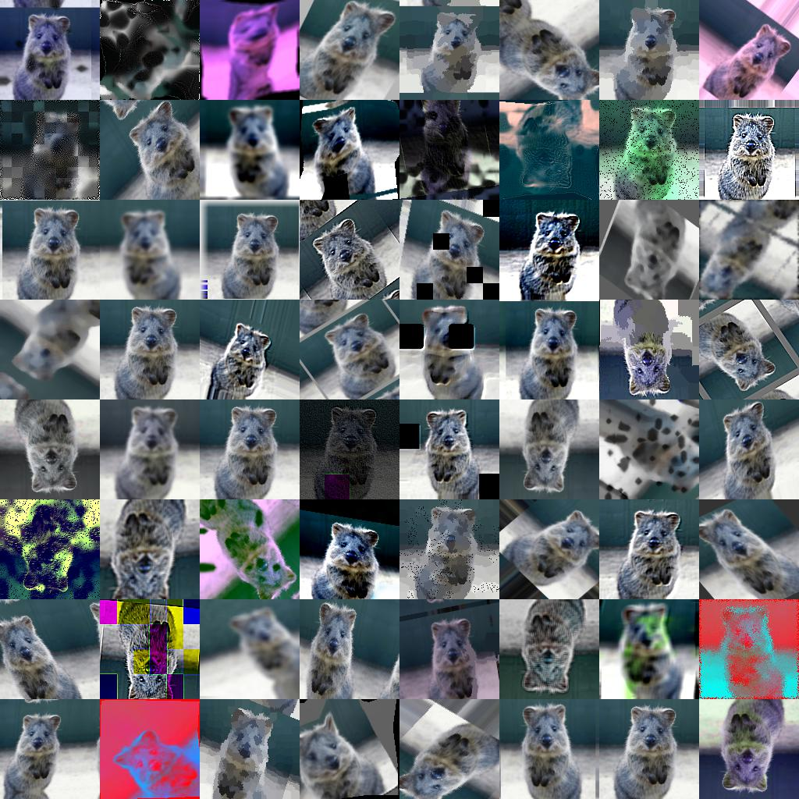
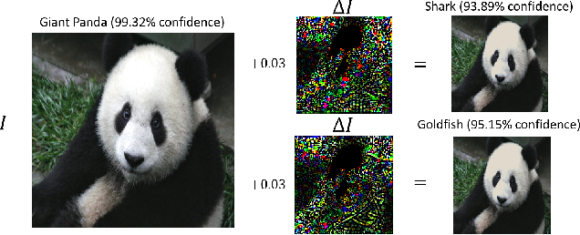
Variation in Images Is a Problem
Adverserial
Natural

Slide 7
What problem are we trying to solve?
How sensitive are cutting edge deep object detection networks to natural noise/errors/variation in images?
What kind of process and metrics should be used to quantify this sensitivity?
Can our analysis be used to provide a context of which networks to use in different contexts?

Slide 8
Why is this problem important?
Safety Applications
A practical understanding or methodology for determining how Deepnets fail is crucial if we expect to use deep nets in safety concerned applications, such as autonomous driving.
Context Specific Applications
Field focus is on “new” networks.
Little knowledge of practical use “in the wild”.
Lack of Rich Performance Metrics
Standard ML metrics don’t map very well to object detection.
There aren’t rich metrics that quantify things like “color sensitivity”

Slide 9
What is the current state-of-the-art?
Networks:
Mask R-CNN, RetinaNet, Faster R-CNN , RPN , Fast R-CNN , R-FCN, YOLO
Backbones: ResNeXt{50,101,152} , ResNet{50,101,152} , Feature Pyramid Networks , and VGG16
Datasets:
COCO (Multi-object Detection Dataset)
PASCAL VOC (Multi-object Detection Dataset))
Kitti (Autonomous Vehicle Object Detection Dataset)
Analysis:
Simple aggregated performance metrics
Adversarial based analysis

Slide 10
Our Approach
Benchmarking and Sensitivity Analysis:
Select most cutting edge networks.
Perform performance analysis on core images.
Generate images with “natural” errors/noise/variation.
Perform performance analysis on transformed images.
Compare/contrast performance to draw insights about deep network sensitivities across different network kinds.

Slide 11
The Specifics
Networks:
10 networks (Requires 11GB Graphics Cards)
<Net Arch>_<Net Backbone>-<Proposals>_2x
e2e_faster_rcnn_R-101-FPN_2x
e2e_faster_rcnn_R-50-C4_2x
e2e_faster_rcnn_R-50-FPN_2x
e2e_faster_rcnn_X-101-64x4d-FPN_2x
e2e_mask_rcnn_R-101-FPN_2x
e2e_mask_rcnn_R-50-C4_2x
e2e_mask_rcnn_R-50-FPN_2x
retinanet_R-101-FPN_2x
retinanet_R-50-FPN_2x
retinanet_X-101-64x4d-FPN_2x
Images:
COCO image validation data set.
5000 base images (600x800 3 channel images)
50 Transforms generating 250,000 images total
5000*50*10*(300 proposals/net) = 750 Million object candidates
Systems:
8 GTX 1080ti GPU system with 11GB per Card, 8 GB Ram
i7 CPU, 24GB Ram
Condor instances

Slide 12
Image Transforms (50 total)
Value Transforms:
Blur based
Region based
Color based
Lighting based
Spatial Transforms:
Scaling based
Orientation based
Translation based
Distortion based

Slide 13
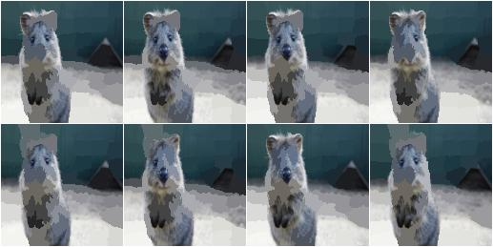
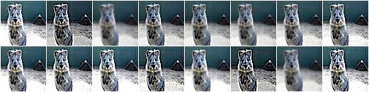
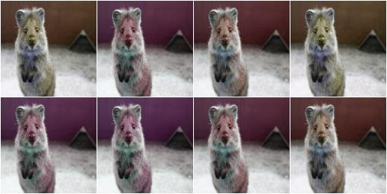
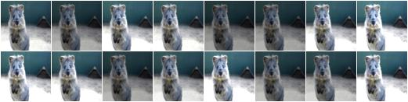
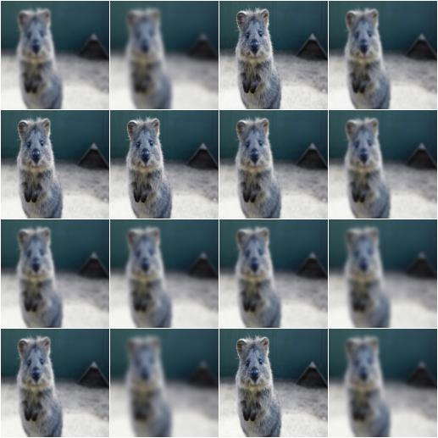
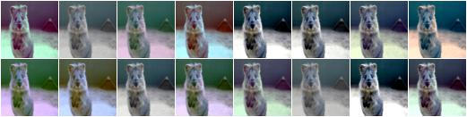
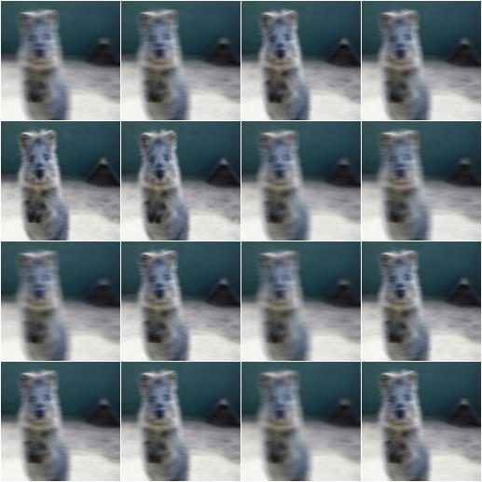
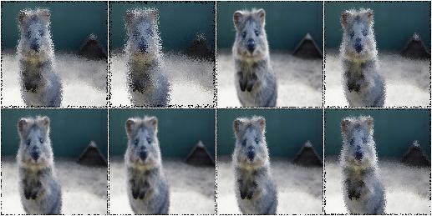
Example Value Transforms
Super Pixels
Sharpen
Colorspace Hue
Intensity Multiply
Gaussian Blur
Contrast Normalize
Average Blur
Locality Shuffling

Slide 14
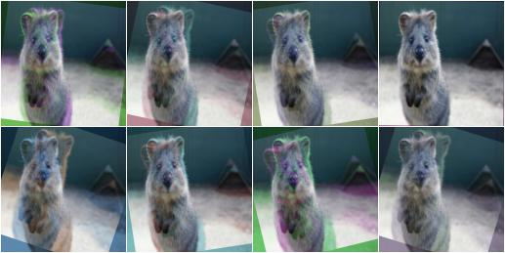
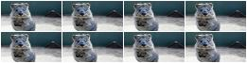
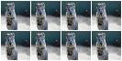
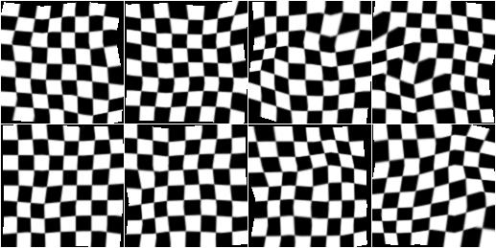
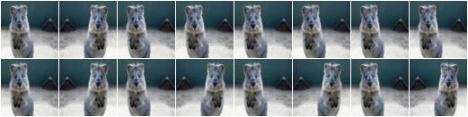
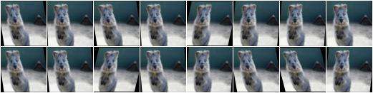
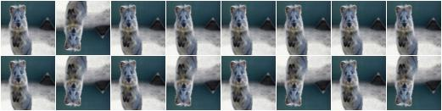
Example Spatial Transforms
Blend/Overlay
Scale
Flip L/R
Piecewise Affine
Flip U/D
Affine Scale

Slide 15
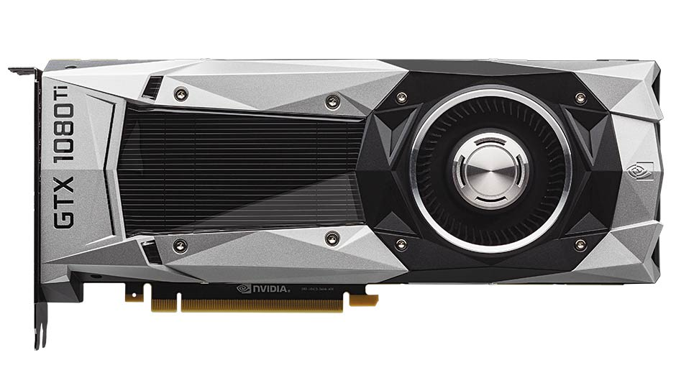
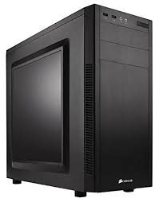

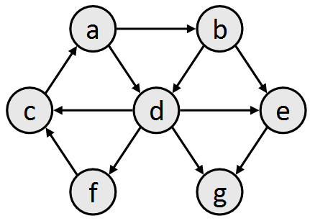
Our Pipeline
Image Transformation
Object Detection
Analysis and Visualization
Understanding
GPU System
CPU System
CPU System
CPU System
Condor System

Slide 16
Results
Compare our results with results reported in the papers!!!!! How different are they???

Slide 17
Results

Slide 18
Results

Slide 19

The Short Summary

Slide 20
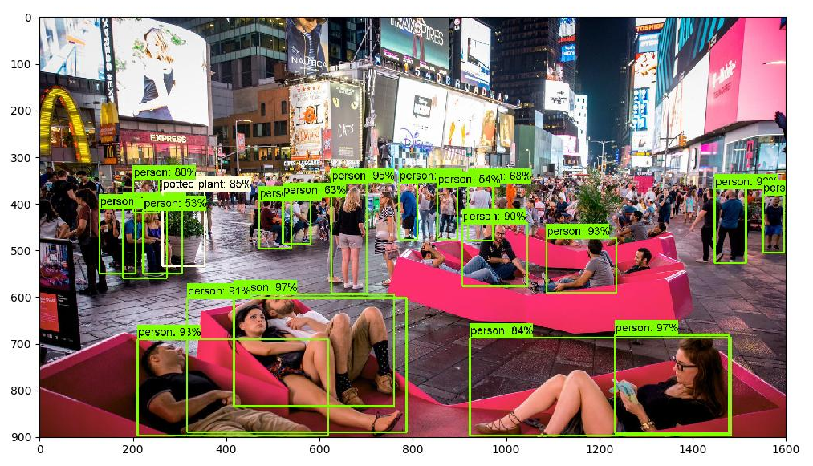
The Long Summary
What did we learn from doing this project?
Most networks are brittle and need more work to make them robust.
Next Steps for This Project?
Sensitivity Analysis Toolkit.
New Sensitivity.
Next Steps for This Area?
Amount of re-training needed to reduce errors?
Architectural changes/constraints needed to reduce errors?
How much reducing network size for memory/speed affects errors?

